Slide 1
Sales & Profit Dashboard – Coffee Chain
Prepared by: Priyanshi Sheladiya
Tool Used: Power BI

Slide 2
Objective
The goal of this dashboard is to provide key sales and profit metrics for the Coffee Chain business. It enables business stakeholders to monitor performance, identify trends, and make informed decisions.

Slide 3
Dataset Overview
- Source: Kaggle / Provided
- Columns Used:
• Date
• Product
• Product Type
• Market
• Region
• Sales
• Profit
• Margin

Slide 4
KPIs Tracked
- Total Sales
- Total Profit
- Total Margin
- Profit Margin %
- Sales & Profit Trends
- Regional Performance
- Product-wise Performance

Slide 5
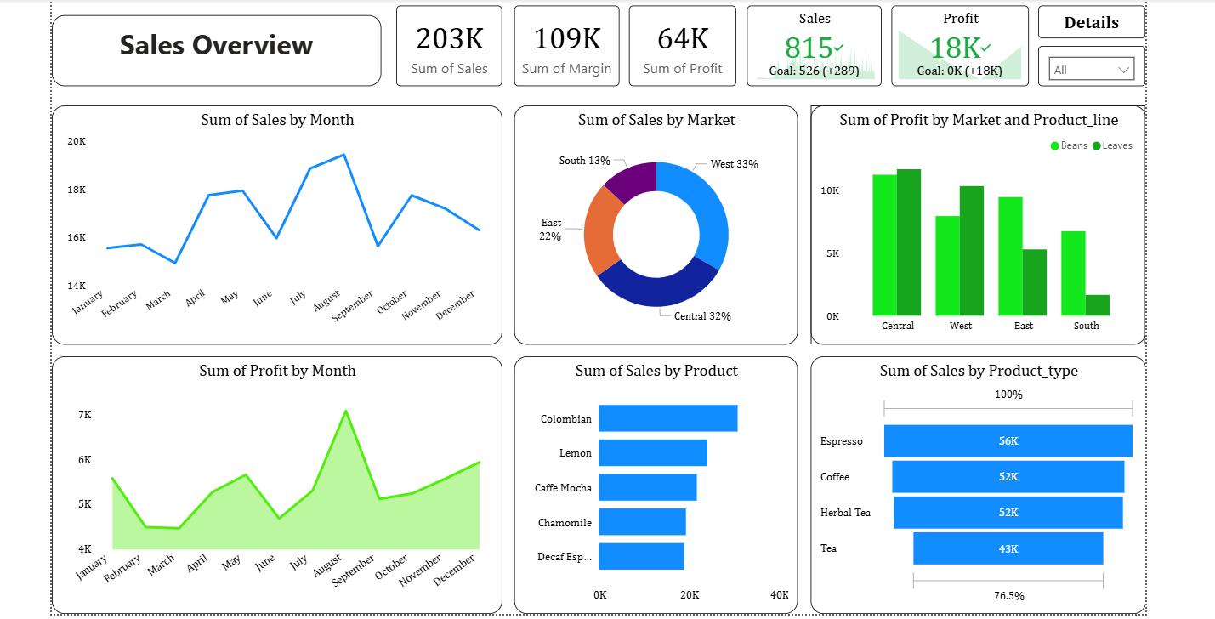
Dashboard Screenshot

Slide 6
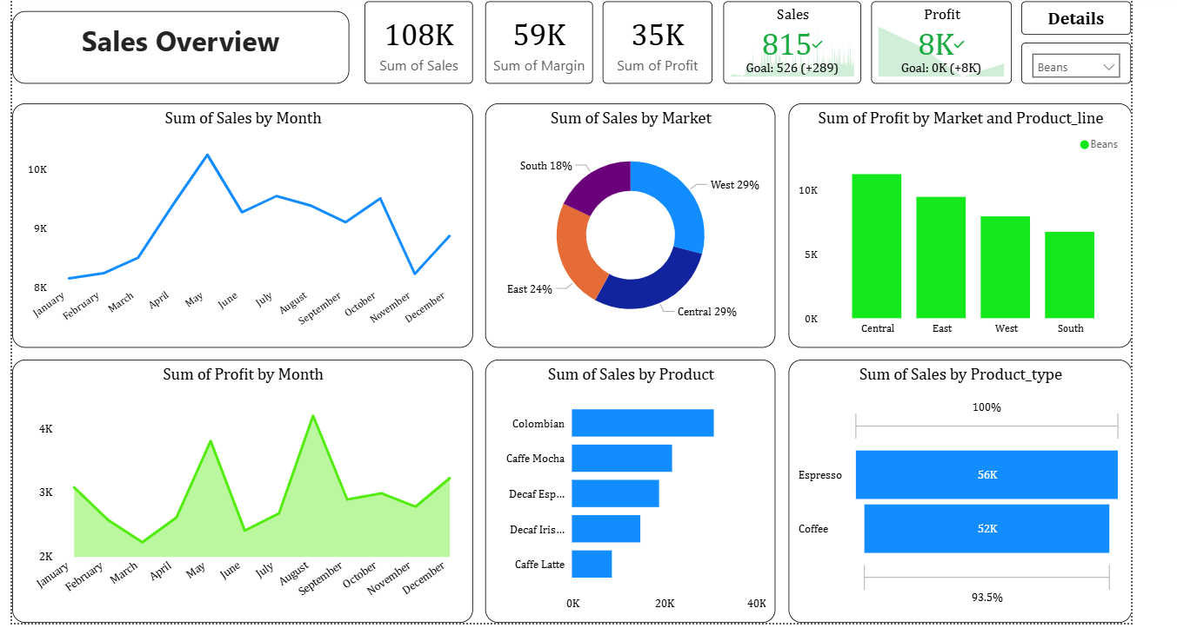
Dashboard Screenshot

Slide 7
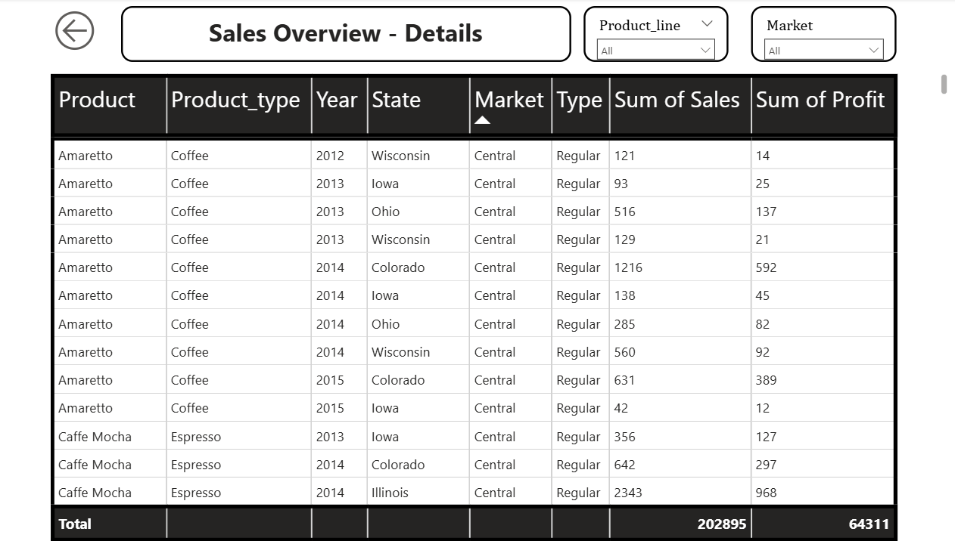
Sales Detail - Navigation

Slide 8
Conclusion
This interactive dashboard provides a clear view of business performance across time, products, and regions. It helps stakeholders identify growth opportunities, underperforming areas, and make data-driven strategic decisions.

Slide 9
THANK YOU
Priyanshi Sheladiya

